Slide 1





AIR POLLUTION
DEVICE BASED
Detection and Alarming System
By Sagarika Srivastava

Slide 2
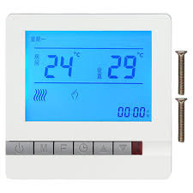
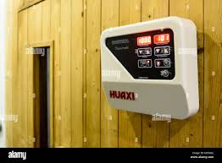
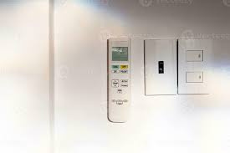

FINAL PRODUCT
- Will Look Like This

Slide 3
FUNCTIONS OF MY DEVICE
SENSOR TO DETECT AIR QUALITY AND CONTENTS PERCENTAGE WISE
O2-% CO2-% ETC
LIGHT FOR INDICATION (RED YELLOW GREEN)
DISPLAY AIR QUALITY
ALARMING SYSTEM IN CASE OF FIRE
LARGE RADIUS
CAN TELL THE DIFF BETWEEN ACTUAL SMOKE AND A PERSON SMOKING
WIFI connectivity
RUNS ON BATTERY FOR POWER SUPPLY
ECONOMICAL
All combined in one single device that can be hanged on the wall

Slide 4
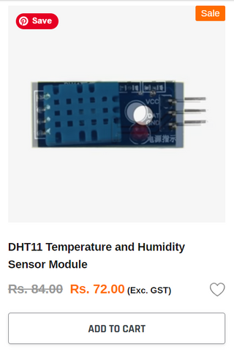

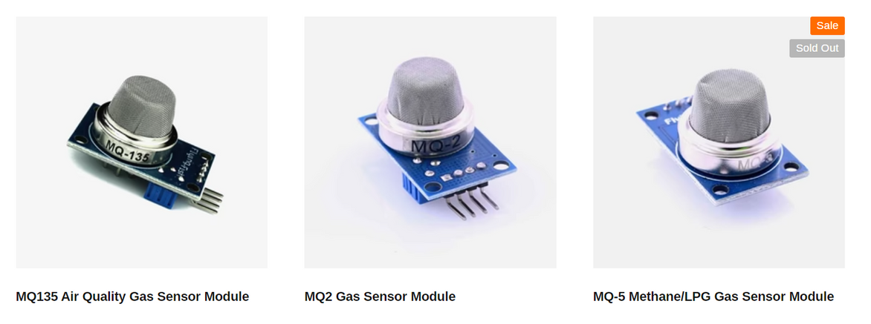
BASIC SENSORS REQUIRED
AIR QUALITY AND GAS SENSORS
TEMPERATURE AND HUMIDITY SENSOR
PROXIMITY SENSOR for increased area coverage

Slide 5
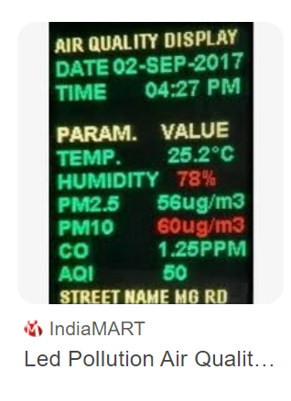
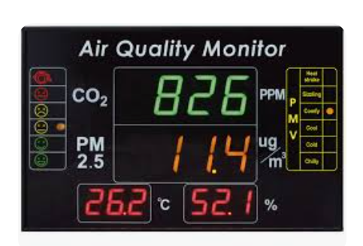
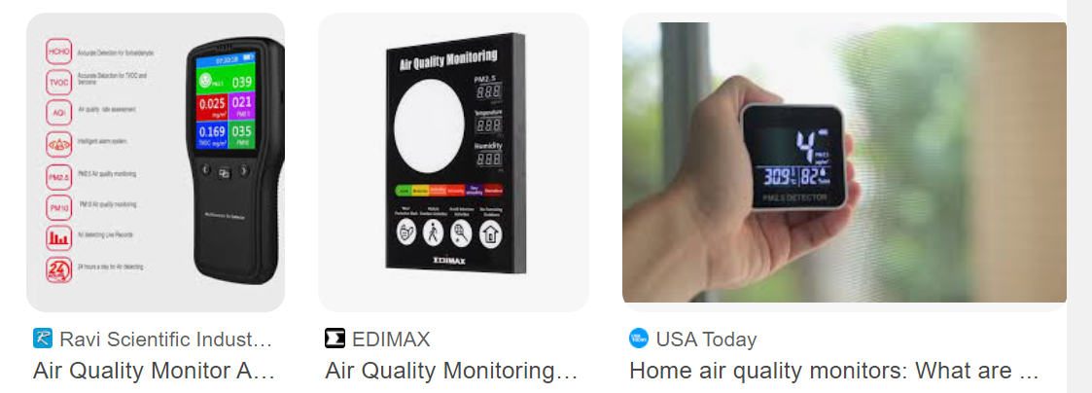
DISPLAY
Level of harmful gases
notification to take action

Slide 6
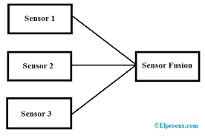
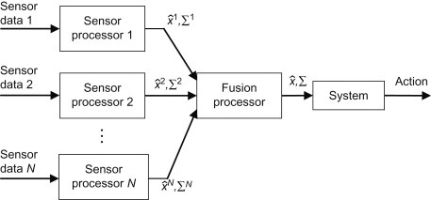
COMBINING THE SENSAORS USING SENSOR FUSION
Sensor fusion is the process of merging data from multiple sensors such that to reduce the amount of uncertainty that may be involved in a robot navigation motion or task performing.

Slide 7



NOTIFICATION LED
A Notification LED is a small RGB or monochrome LED light usually present on the front-facing screen bezel (display side) of smartphones and feature phones whose purpose is to blink or pulse to notify the phone user of missed calls, incoming SMS messages, notifications from other apps, low battery warning, etc.,

Slide 8
THANK YOU
By Sagarika Srivastava

